Slide 1

The Quest for Genuine Freedom
In Defense of Kierkegaard’s Upbuilding of Faith and the Unity of Temporality and Eternity
Sue McRae
PhD Candidate/Teaching Fellow
University of North Texas
Department of Philosophy and Religion
Notes:
Welcome back to this series of lectures entitled “ The Quest for Genuine Freedom: In Defense of Kierkegaard’s Upbuilding of Faith and the Unity of Temporality and Eternity. This is the third of four lectures. Today we have ONE small discussion group covering Kierkegaard’s Original Synthesis and Selfhood, in which you will converse with your neighbors in class about our journey through time and eternity with the “father of existentialism”, Søren Kierkegaard (1813-1855) in philosophy. As mentioned last week, we will then re-convene in our large group to discuss what we addressed in our small group discussions. As always, feel free to ask questions and provide commentary as we move through the content. Questions and comments are always welcome after class as well!

Slide 2
Welcome Back to Class!
Notes:
Welcome back to class! I am so glad to see you all here again, ready to embark upon this journey with me for the third session of the course! As you know, we will meet for our final class this Wednesday the 8th of October, 10:00-11:30 (same time, same place) for our concluding lecture.

Slide 3
Overview for Today
Introductions?
Brief Review of last Wednesday’s slides
SMALL GROUP DISCUSSION QUESTIONS
KIERKEGAARDIAN ETHICS
THE INWARD JOURNEY TO GOD AND THE “LEAP OF FAITH”
Large GROUP DISCUSSION QUESTIONS
A Challenge to Kierkegaard’s original synthesis and the inward journey to god: Sartre, De Beauvoir, and the Freedom of the For-Itself
Large Group discussion questions
Simone De Beauvoir’s Approach to freedom
Kierkegaard’s freedom in faith
Large Group DISCUSSION QUESTIONS
Notes:
So, I always begin my classes with an overview for today’s lecture. We will begin with A BRIEF REVIEW OF LAST WEDNESDAY’S SLIDES; then on to Kierkegaardian Ethics; the Inward Journey to God and the “Leap of Faith”, followed by some Large Group Discussion Questions.
Then we take a turn to a major CHALLENGE to Kierkegaard’s Original Synthesis and the Inward Journey to God: Sartre and De Beauvoir (TWO TWENTIETH CENTURY HEIRS TO KIERKEGAARD’S 19TH CENTURY PROTO-EXISTENTIALIST THOUGHT) and the Freedom of the For-Itself.
We will then proceed with another large group discussion, followed by a slide covering Simone de Beauvoir, who took her own approach to the idea of Freedom, distancing herself from her life partner Jean-Paul Sartre’s philosophy of the For-Itself, instead focusing on the Ambiguity of Ethics. This is an excellent book to add to your existentialist library if you are interested in learning more about the de Beauvoirian ethics of ambiguity (show book) and it is quite a bit less challenging than this classic by Jean-Paul Sartre, Being and Nothingness (show book), but reading it is quite the accomplishment if you dare!
We will then return to Kierkegaard’s ideas about Freedom in Faith and conclude with another Large Group Discussion. Time permitting. I wanted to include more small group/breakout groups, but judging from the last two sessions, we are time-limited. There just never seems to be enough TIME (what a subject to cover in philosophy and religion!). I would love to turn this into an eight week seminar someday to be able to really dive deeper into this topic. I am putting that on my list of possibles.
Looking forward to Wednesday, we will begin with the questions at the end of today's class and process those, then cover our major topic of the day: TIME AND THE UNITY OF TEMPORALITY AND ETERNITY; TIME AND ETERNITY; have another breakout/small group discussion session; then consider KIERKEGAARD’S “LEAP OF FAITH” AND THE PARADOX OF CHRISTIANITY within the THE UNITY OF TEMPORALITY AND ETERNITY:
We want to make time for a short video clip which I Believe reflects this paradoxical nature of Christianity, and then we will consider some conclusions about Kierkegaard’s idea of GENUINE FREEDOM.
TIME PERMITTING, WE WILL HAVE ONE LAST LARGE GROUP DISCUSSION AND I WILL MAKE A FEW CLOSING REMARKS and provide some resources for further research on this topic. If for some reason we are limited by time, we may need to speed up through some of the content moving forward, pPease note that you have the PowerPoint slides and notes available to you through the OLLI website, and I will make sure you have my contact information if you want to chat about this or other Kierkegaardian subjects.

Slide 4
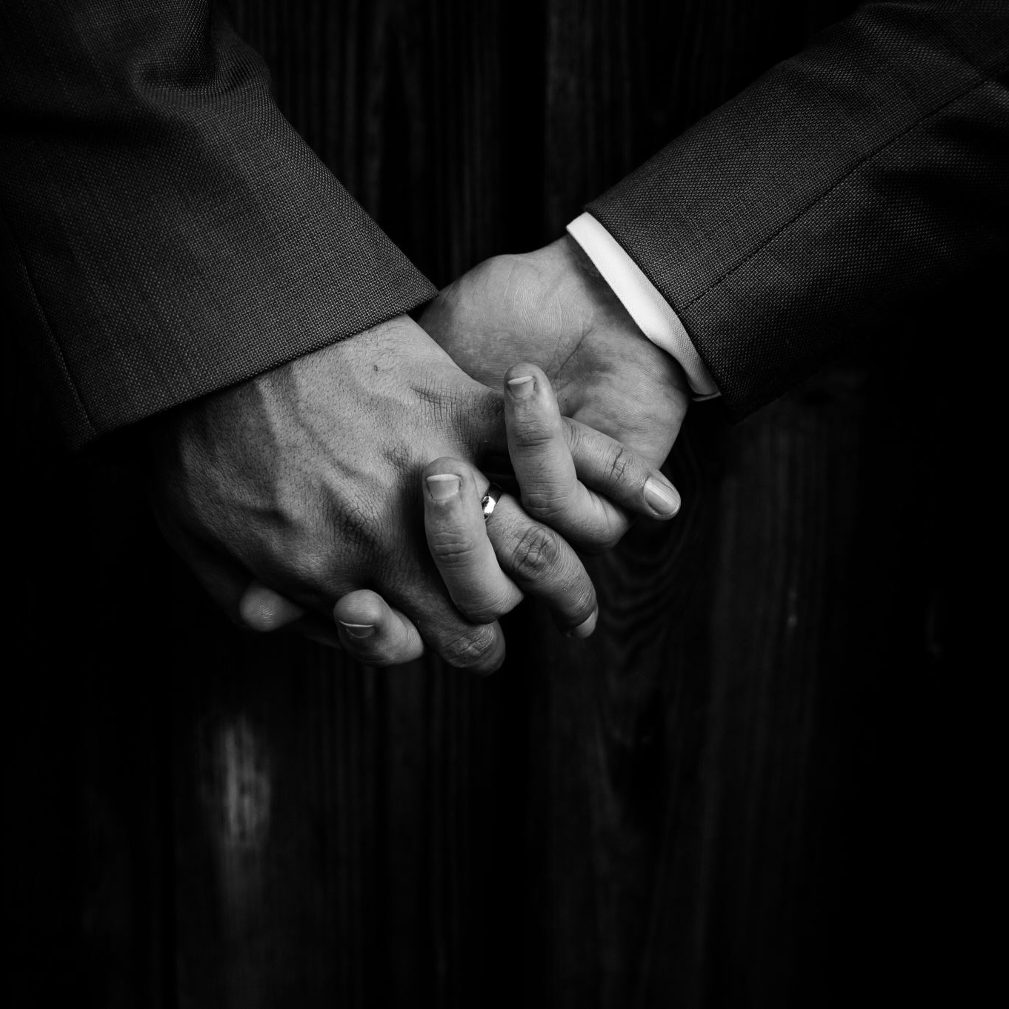
Introductions
Tell me a bit about yourself!
Tell me your name and why you are interested in this class in particular?
any experience reading Kierkegaard or familiarity with his philosophy?
Interest in or familiarity with the sub-discipline of existentialism in philosophy?
Favorite pastimes, hobbies, interests in life?
Finally, how did you hear about the OLLI program, and are you taking other courses here as well this semester? Which Ones?
Just anything you want to say about yourself, brief or a bit more detailed… the floor is yours!
Notes:
First, I want to ask, Are there any newcomers to the course today? If so, I also like to begin class with Introductions, so I will begin with telling you BRIEFLY who I am and why I am teaching this course.
My name is Susan McRae – I go by Sue – Having completed my fourth year as a PhD student and Teaching Fellow in Philosophy and Religion, I am continuing my journey in the department as a fifth-year Teaching Fellow teaching PHIL 1050 Introduction to Philosophy this semester. As a PhD Candidate (ABD), which stands for “All But Dissertation). and having completed all my coursework, I am now in the final “writing of the dissertation” phase of my PhD program. I have decided to focus on the question of the animal in philosophy and religion, with particular interest in the connections between Søren Kierkegaard's Christian philosophy/theology (faith as true ethic), animal ethics, and his views on animals, which have rarely been studied in philosophy.
As stated before, I have been a student at UNT for quite some time, since 2008. So, I am also a lifelong learner like you all! I would like to hear from the newcomer(s) a brief introduction. I have posted some questions to consider on this slide, so please tell me a bit about yourself!

Slide 5
Kierkegaard’s Original Synthesis
Notes:
Last Wednesday, we covered Kierkegaard’s Original Synthesis. You can look up the notes on this slide in the PowerPoint posted for that day for what this term “Original Synthesis” means. Basically, we moved into the metaphysical realm with Kierkegaard. This diagram is also on your handouts.

Slide 6
Selfhood
Celestial
Divine
Infinite
Eternal
Freedom
Possible
Terrestrial
Human
Finite
Temporal
Necessary
Actual
Self is a spirit – the spirited component of life.
The self [is a] synthesis
The self is a conjoining, [it is] activity driven, a creative act whereby we are making ourselves what we are and what we are to become.
As a fusion of these polarities, the self is a relation which relates to itself, or that in the relation which is its relating to itself. Not the relation but the relation’s relating to itself.
Notes:
We covered the very notion of selfhood from Kierkegaard’s proto-existentialist standpoint as an interiority of being, an inner movement within the original synthesis harnessed by polarizing nodes of terrestrial/celestial; human/divine; finite/infinite; temporal/eternal/necessary/freedom/and actual/possible. The last two nodes are intimately related: necessary/actual: freedom/possible.
Challenging nineteenth century German idealism (especially Hegel’s “System”) and asserting that “subjectivity is truth”, Kierkegaard posited the self of the human being as the spirited component of being, or the Geist. As stated in The Sickness unto Death:
The human being is spirit. But what is spirit? Spirit is the self. But what is the self? The self is a relation which relates to itself, or that in the relation which is its relating to itself. The self is not the relation but the relation’s relating to itself
Carpenter, 1967, 38.
Kierkegaard, Søren. The Sickness unto Death (A. Hannay, Trans.). Hammondsworth, England: Penguin. 1989. (Original work published 1849), 43.
This classical synthesis is limited for K. and only makes sense in terms of God, which later existentialist thinkers vehemently challenged, believing humans to be finite. We also covered the third-man argument posited by Aristotle, so you may want to look back over your notes on this slide and also review the PowerPoint from Wednesday with my notes.
Herein lies the tension between K. and later thinkers: the viewpoint that man is only finite and mortal, his freedom ossified into the facticity of the past in a moment-to-moment war between present and future. For Sartre, de Beauvoir, and other fashionable atheists of the twentieth century, freedom always originates in the self as it transcends itself towards the world, yet there is nothing beyond that self which gives this freedom meaning.
Returning to Kierkegaard, the freedom to choose one’s being rests securely in the interiority of the self as spirit, which necessarily points to a spiritual realm and therefore something superior to this world and being, namely God. Indeed, the human condition calls for great feats of courage and moral fortitude to confront the existentialist despair which originates in the relation of the relation of the pairings: Ibid., 46.
FINALLY, AND THIS IS A MAJOR POINT, WE DISCUSSED THE IDEA OF THE MISRELATIONS THAT OCCUR BETWEEN THESE POLARIAZING NODES. THE TENSION BETWEEN THEM IS EVER-OSCILLATING, AND ANY MISRELATION RESULTS IN ONE OF THE 20 FORMS OF DESPAIR WHICH ARE COVERED IN THIS BOOK, THE SICKNESS UNTO DEATH” (SHOW BOOK), ANOTHER DIFFICULT BUT CLASSIC BOOK FOR YOUR KIERKEGAARDIAN/EXISTENTIALIST LIBRARY. 20 FORMS OF DESPAIR, AND ONLLY ONE WAY OUT: GOD.

Slide 7
Small Group Discussion Questions
Do you think of your “self” as a spirit, the spirited component of the life you have lived so far?
Is the “self” a conjoining of these binary opposites, activity driven, a creative act whereby we are making ourselves what we are and what we are to become?
Which of the binary opposites do you relate to the most, and how does the misrelation between the two cause you despair, or does it?
Recall the binary opposites: Terrestrial/Celestial; Human/Divine; Finite/Infinite; Temporal/Eternal; Necessary/Freedom; and Actual/Possible.
Refer to the handout as well of you need a reminder of the diagram.
Notes:
So, after this brief review, let’s break into our small groups and answer the following questions. There is no “Right” or “Wrong” answers to these, and often it is the questions that arise in your discussion groups that lead to the most productive work in philosophy. So lets take a few minutes and talk about these questions on the board.
Ok, so what did we come up with?
Do you think of your “self” as a spirit, the spirited component of the life you have lived so far?
Is the “self” a conjoining of these binary opposites, activity driven, a creative act whereby we are making ourselves what we are and what we are to become?
Which of the binary opposites do you relate to the most, and how does the misrelation between the two cause you to experience despair, or does it?
Recall the binary opposites: Terrestrial/Celestial; Human/Divine; Finite/Infinite; Temporal/Eternal; Necessary/Freedom; and Actual/Possible.
Refer to the handout as well of you need a reminder of the diagram.
We can spend a few minutes pondering these questions; as before, do take notes. If you like, appoint a speaker for your group, or if everyone wants to contribute when we return to the large group, that’s great too! I will leave you to self-select your groups – last Wednesday we broke into three small groups, so that would be appropriate for this session as well.
If you need me to go back to a certain slide or ask me a question during your breakout group, just call me over.

Slide 8
Kierkegaardian Ethics: A Concrete Example
TRANSFORMATION OF THE PASSIONS: ROMANTIC LOVE TO MARRAIGE
Marriage as ethical, lends to ethical openness (versus aesthetic concealment)
The importance of choice for an AUTHENTIC LIFE (existentialism)
For Kierkegaard, choosing aesthetically is not choosing at all! (This is the first of the three ethical stages: the aesthetic, the ethical, and the religious.
There arises the need to choose choice itself, taking responsibility for the person he has become.
Self-acceptance (facticity in the world) versus self-alienation; The “I” CHOOSES ITSELF.
Seeking a balance between Possibility (too much choice, paralysis of the Will)/Necessity (complete absence of choice).
Voluntary self-limitation: Devotion to work, his wife, his children less a sacrifice than the source of joy and satisfaction (God) (RELIGIOUS PHASE)
The ethical only appears to be grounded in social requirements and expectations for Kierkegaard, but…. The religious life also comes into play (and Kierkegaard is highly critical of organized religion!). So, we are moving toward a more personal relationship with God.
Notes:
Moving along, I want to briefly cover a more generalized idea of Kierkegaardian ethics as it relates to these notions of selfhood and introduce you to his emphasis on authenticity, as Kierkegaard at times writes and speaks of “the transformation of the passion”, with a concrete example (concrete examples in philosophical discussion ALWAYS help me to clarify some of the more difficult analytical approaches!) of romantic love compared to marriage, This is a palatable example of Kierkegaardian ethics which probably relates back to his broken heart and the tragic ending of his relationship with Regina Olsen, his true love. He did marry later, but he lived a life of regret, it has been said.
The source for this slide is Kierkegaard’s Either/Or, in which he takes the reader through the ethical stages of life. Another good book for your Kierkegaardian library. For Kierkegaard, Marriage is ethical when compared to romantic love, lending itself to ethical openness (versus aesthetic concealment).
The basic premise of Either/Or:
Explores the dichotomy between aesthetic and ethical life choices.
Presents two distinct ways of living: the aesthetic (pleasure-seeking) and the ethical (commitment and responsibility).
Emphasizes the importance of personal choice and individual existence.
Discusses the implications of choosing one path over the other.
Highlights the tension between freedom and the constraints of societal norms.
Encourages readers to reflect on their own life decisions and values.
Ok, what does aesthetics refer to in philosophy do you think?
Conventionally, “aesthetics” refers to a theory concerning beauty and art or the branch of philosophy that studies these topics. However, many of the romantics rejected the identification of aesthetics with a circumscribed domain of human life that is separated from the practical and theoretical domains of life. The most characteristic romantic commitment is to the idea that the character of art and beauty and of our engagement with them should shape all aspects of human life. Being fundamental to human existence, beauty and art should be a central ingredient not only in a philosophical or artistic life, but also in the lives of ordinary men and women. (From Stanford Encyclopedia of Philosophy under the title “19th Century Romantic Aesthetics)
Ok, first of all, what is aesthetics according to Kierkegaard in philosophy?
1. Aesthetics is one of the stages of life, focusing on sensory experiences and pleasures.
2. It emphasizes the pursuit of beauty and immediate gratification over deeper meaning.
3. The aesthetic life is characterized by a lack of commitment and existential anxiety.
Kierkegaard contrasts aesthetics with the ethical stage, which involves responsibility and choices.
4. He argues that a purely aesthetic life leads to despair and a sense of emptiness.
Ultimately, Kierkegaard suggests that true fulfillment comes from moving beyond aesthetics to a more meaningful existence.
So, what does “aesthetic concealment mean” to you?
The three ethical stages are as follows for Kierkegaard:
Aesthetic Stage: Focuses on personal pleasure and immediate satisfaction; life is driven by desires and experiences.
Ethical Stage: Emphasizes moral responsibility and commitment; individuals make choices based on societal norms and values.
Religious Stage: Involves a personal relationship with the divine; transcends ethical norms through faith and individual belief.
As an aside, Aesthetics is one of the major philosophical sub- disciplines and very popular these days, relating to the arts in particular but many other disciplines as well, especially with respect to crossovers with anthropology, sociology, and, really all the biological sciences; even medicine, multimedia projects, music, you name it.
Kierkegaard stresses the importance of choice for an authentic life (existentialism)
Choosing aesthetically is not choosing at all; there is a NEED to choose choice itself (relates back to the polarities/interiority of the self), taking responsibility for the person he has become. What do you think he means by this?
Kierkegaard urges self-acceptance (facticity in the world) versus self-alienation, such that the “I chooses itself” (also referring to selfhood and the interiority of being.
For your general existentialist notes, “facticity in the world” is a very common phrase, taken up later especially by Martin Heidegger in his book, Being in Time, the hardest book I have ever read, but a great one to conquer! (Show book)
Facticity in the World:
Definition: Facticity refers to the concrete details and conditions of existence that shape human life.
Existentialism: Central to existentialist thought, emphasizing the importance of individual experience and context.
Human Condition: Highlights the limitations and circumstances that define our choices and actions.
Authenticity: Encourages individuals to acknowledge their facticity to live authentically and make meaningful choices.
Historical Context: Recognizes that facticity is influenced by historical, cultural, and social factors.
Philosophical Implications: Raises questions about freedom, responsibility, and the nature of reality in human existence.
So, Kierkegaard is seeking a balance between possibility (in which too much choice paralyses the will)/and necessity (the complete absence of choice) [REFERRING AGAIN BACK TO THE POLARITIES/NODES OF THE ORIGINAL SYNTHESIS/SELFHOOD)
Kierkegaard urges VOLUNTARY SELF-LIMITATION: : Devotion to work, his wife, his children being LESS a sacrifice than the Source of joy and satisfaction (God). So, this is the first STAGE of the ethical journey.
1.

Slide 9
The Inward Journey to God
Despair as a misrelation of the synthesis, a sickness of the spirit
The Sickness Unto Death
Knowing oneself in relation to God
Standing before God from within
The “leap of faith” towards the Kingdom of God
The inward journey of despair into hope Genuine freedom
Notes:
So, an understanding of Kierkegaard’s three ethical stages leads us to a better understanding of the inward journey to God, the next BIG Kierkegaardian theme.
Like twentieth century existentialists, Kierkegaard believes we are world-constituting individuals, yet these binary relations are given to us by God.
For Kierkegaard writing as Anti-Climacus in The Sickness unto Death, despair is a misrelation of the synthesis, a sickness of the spirit, the “sickness unto death” which may also be applied to the loss of faith in God and acceptance that “as far as the individual is concerned, death is indeed the end”.
As indicated by the subtitle of The Sickness unto Death, Kierkegaard intends his work for the upbuilding of faith in God, an “edification and awakening”. This is especially important for those who have rejected the God of Christian dogma and seek a genuine and authentic personal relationship with the Creator-within, the salvation provided by His grace and salvation through Christ. However, a “fundamental fear of conscious selfhood” by which one answers directly to God must be OVERCOME so as to catapult oneself over the obstacle of despair into the welcoming pool which is faith and hope for the eternal relationship of the self as spirit to the origin which IS God. Further, one is more oneself the more one conceives of God, answering to “eternal demands of an ethical nature”.
For Kierkegaard, essence precedes existence, yet essence also equals existence in the self that contains and is the kernel of God’s spirit in the world. One’s responsibility to others originates in an ethics of love which is freely given by God to His special creation: man. Seeking to edify, or uplift the reader, Kierkegaard recognizes the loneliness which man feels in his unique condition in the world, a despair resulting from misrelation between the polarities of his being.
Yet by facing one’s fears and loneliness, by standing before God, man has the opportunity to take “the leap of faith” and believe in salvation, life after death, true immortality in the eternal and infinite dimensions, the Kingdom of God.
Genuine freedom therefore arises through the inward journey of despair into hope, which colors all a man’s actions while still in the earthly realm. This inward journey of despair into HOPE leads to GENUINE FREEDOM.

Slide 10
Discussion Questions
How does one “stand before God” from within? What does one say to God or one’s Higher Power; Universal Truth, or Intelligent Designer?
If one knows oneself in relation to God (the higher self-God relationship relating to the self-self relationship, which is a constant oscillation relating itself to the relation’s relation), how does one move from possibility to actuality when taking “the leap of faith” to repair the misrelation of the aspect of the synthesis which is producing despair in the concrete world (“Here”)?
When taking “the leap of faith”, how does one let go of all the attachments to despair that arise in the often-longstanding misrelation that has been plaguing the individual without their knowledge?
Notes:
So, as a large group discussion let’s tackle some existential questions.
How does one “stand before God” from within? What does one say to God or one’s higher power; Universal Truth, or Intelligent Designer?
If one knows oneself in relation to God (the higher self-God relationship relating to the self-self relationship, which is a constant oscillation relating itself to the relation’s relation), how does one move from possibility to actuality when taking “the leap of faith” to repair the misrelation of the aspect of the synthesis which is producing despair in the concrete world (“Here”)? Can you give me a concrete example in your own life?
When taking “the leap of faith”, how does one let go of all the attachments to despair that arise in the often-longstanding misrelation that has been plaguing the individual without their knowledge?

Slide 11
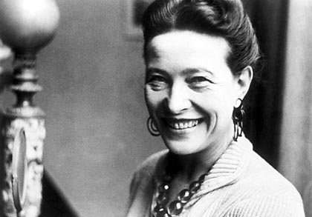
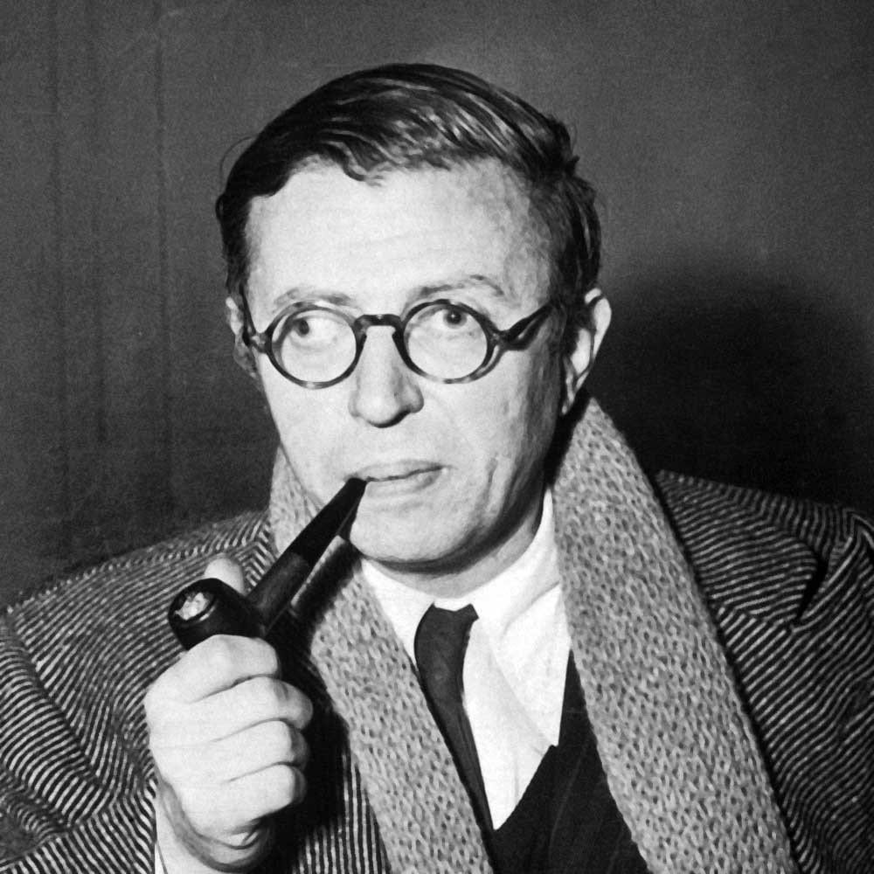
A Challenge to Kierkegaard’s Original Synthesis and the Inward Journey to God
Sartre, de Beauvoir, and the freedom of the For-Itself
Notes:
Drawing on Kierkegaard’s notion of despair, one twentieth century existentialist stated:: “[D]espair leads straight to totalitarianism which is based on the meaninglessness of life and the nonexistence of the person”. Indeed, by the time of Hitler’s Third Reich, despair had become the essence of life, a “Nazi glorification of self-immolation” as the only act that can make man exist meaningfully. Both Sartre and de Beauvoir were heavily invested in confronting and bringing to the surface these nihilistic characters around the time of the Second World War, a “hat’s off” to their approach. In other words, they were seeking meaning in a meaningless world, even though Sartre eventually came to the conclusion that “Man is a useless passion”
What he meant by this:
Existentialism Focus:
Sartre emphasizes the absurdity of human existence without inherent meaning. Freedom is the insistence on a total separation between man and God, creating the absolute disjunction” Either there is a God and man is not free, or there is no God, and man is free (Carpenter, 1966, p.82). Yet, this is an artificial antithesis between being dependent and being free based on the erroneous assumption that to receive is incompatible with being free (ibid, p. 83). This notion of man’s radical freedom for Sartre states that with the death of God, He [man] has no choice left but to create, “with the surpassing creativity of the Creator”, yet he has nothing to fall back on; he is abandoned; he is free to make of himself what he will; a “dreadful freedom” […]”condemned to be free” (ibid.).
Sartre’s doctrine is fundamentally nihilistic; even with authentic existence as something of value, man’s entire responsibility for his actions.
Freedom and Responsibility:
Humans are free to create their own essence, but this freedom can feel burdensome. Without freedom I cannot choose, and because I have freedom, I have no choice but to choose! Yet for de Beauvoir, as we will see, by exercising my original freedom, a freedom that flows from my ontological status as a for-itself (Ontological means relating to the branch of metaphysics dealing with the nature of being), I open myself up to the possibility of choosing wrongly. To understand how I can choose wrongly in the absence of objective values that could provide an absolute standard from distinguishing right from wrong choices is to understand why the exercise of freedom is always an ethical act.
Passion as a Struggle:
The term "useless passion" reflects the struggle for purpose in a seemingly indifferent universe.
Sartre maintained that human behaviour is based on this fundamental and indefeasible desire to be God, but the structure of human consciousness ensures that the desire (and the notion of God) is contradictory,…
Being God is, of course, a very different goal from being placed in God’s hands, as Kierkegaard maintained.
Desiring to be God, the being-for-itself’s futile attempt to be re-absorbed by the being-in-itself leads to entrapment within the anguish and failure of this movement outward. Daily we choose freedom, whether given to us by God as free will or as originating as the dance of freedom and necessity, a cause-and-effect chain of events.
Rejection of Predefined Roles:
Sartre argues against societal roles, suggesting they limit individual freedom and authenticity.
Emotional Experience:
The phrase highlights the emotional turmoil and existential angst that accompany human life.
Search for Meaning:
Ultimately, it underscores the human quest for meaning in a world that offers none inherently.
In a shift from rational universal representationalism and scientific objectivity to the emotive, affective, subjective introspection which accompanied phenomenology, twentieth century existentialists like Sartre and de Beauvoir focused on the erosion of cultural values, the actions of humans over intellectual concerns. Values of the individual and of society are reflected in personal and societal behavior, and behavior reflects these values back in a circuit of selfness, the movement of the transcendent ego.
Kierkegaard’s reflexivity approach was taken up by twentieth century existentialists, yet their assumption leaves OUT the possibility that the self could have been established by something else, namely God. Further, God, who “made man this relation, as it were, lets go of it; that is, from the relation’s relating to itself […] and here lies “the accountability under which all despair is, every moment, what it is” . Herein lies the tension: the viewpoint that man is only finitude and mortal, his freedom ossified into the facticity of the past in a moment-to-moment war between present and future. As stated before, for Sartre, de Beauvoir, and other existentialist atheists of the twentieth century, freedom always originates in the self as it transcends itself towards the world, yet there is nothing beyond that self which gives this freedom meaning. Ibid., 46.
In a rationalized, disenchanted, systematized (secular) realm, knowing oneself in relation to God is even more imperative. Yet, it is this alienation from self in the “shock of modernity” which led twentieth century existentialists like Sartre and de Beauvoir to tend towards an externalizing self, one which transcends itself into its being-for-others, though often through acts of bad faith.
WHAT DO YOU SUPPOSE BAD FAITH REFERS TO?
IN BAD FAITH, WE TELL OURSELVES A LIE WHEN WE WANT TO AVOID RESPONSIBILIITY.
Bad faith (mauvaise foi) is a form of self-deception or lying to oneself.
It involves denying one's own freedom and responsibility by adopting false identities.
Individuals in bad faith often conform to societal roles to escape existential anxiety.
Sartre illustrates bad faith through the example of a waiter who overly identifies with his role. (Being and Nothingness)
He also gives an example of a woman on a date in the date’s car (“making out in the back seat of the car” era whose partner wants to have relations with her/is seducing her and she allows it to go forward even though in her mind she does not want to go forward with it – yikes!) She let’s the expectations of her partner/date/seducer overwhelm and take away her authentic self, in fear of judgement by societal norms (the woman is expected to “put out” if she goes on a date like this! Again, YIKES!
It reflects a conflict between one's authentic self and the roles imposed by society.
Overcoming bad faith requires embracing one's freedom and the weight of personal choices.
Further, the Sartrean and de Beauvoirian idea that existence precedes essence is in sharp contrast to Kierkegaard’s notion of self as spirit, and this also makes apparent the distinction between inward and outward approaches to the existentialist notion of freedom and responsibility to others. THIS IS THE MEANING OF THE FOR-ITSELF, WHICH IS CONTRASTED TO THE IN-ITSELF FOR SARTRE AND DE BEAUVOIR.
Definition: "Being-for-itself" refers to conscious existence, characterized by self-awareness and freedom.
Contrast with Being-in-itself: It is contrasted with "being-in-itself," which describes non-conscious objects that lack self-awareness.
Existential Freedom: It emphasizes the idea that individuals create their own essence through choices and actions.
Subjectivity: "Being-for-itself" highlights the subjective experience of existence, where individuals define their own meaning.
Responsibility: It entails a profound sense of responsibility for one's actions, as individuals shape their own lives.
Absurdity: Sartre suggests that life is inherently absurd, and it is up to individuals to find purpose within that absurdity.
Sartre and de Beauvoir will challenge this paradox through ideas of responsibility as shouldered completely by finite man.
For Sartre, “freedom has no foundation, becomes nihilistic, merely a flight from nothingness to nothingness”, Carpenter, 1966, 80.

Slide 12
Discussion Questions
What is the most significant aspect of Sartre and De Beauvoir’s challenge to Kierkegaard’s “Original Synthesis”?
What is the most significant aspect of their challenge to Kierkegaard’s Inward Journey to God?
Does their idea of the Synthesis work without God?
Can the Being-for-Itself make meaning out of life without God in the movement of the transcendent ego? Why or why not?
Which approach are you most attracted to and WHY?
Notes:
So, one more time, as a large group let us discuss this challenge to Kierkegaard’s Original Synthesis and the Inward Journey to God.
What is the most significant aspect of Sartre and De Beauvoir’s challenge to Kierkegaard’s “Original Synthesis”?
What is the most significant aspect of their challenge to Kierkegaard’s inward Journey to God?
Does their idea of the Synthesis work without God?
Can the Being-for-Itself make meaning out of life without God in the movement of the transcendent ego? Why or why not?
Which approach are you most attracted to and WHY? Kierkegaard's or Sartre and de Beauvoir's?

Slide 13
SIMONE DE BEAUVOIR’S APPROACH TO FREEDOM
The Ethics of Ambiguity (1947)
De Beauvoir sets herself apart from Sartre
The journey from Sartrean absurdity (meaninglessness/no meaning at all) to ambiguity (no fixed meaning)
“To make myself a ”lack of being is indeed to make something out of nothing”
FOCUS: The exercise of freedom is always an ethical act
“Freedom wills itself only by destining itself to an open future, by seeking to extend itself by means of the freedom of others”
We move AWAY/TOWARD subjectivity through SEVEN ARCHETYPES
T
AWAY FROM SUBJECTIVITY
THE “SUB-MAN”
THE SERIOUS MAN
THE NIHILIST
TOWARD SUBJECTIVITY
THE ADVENTURER
THE PASSIONATE MAN
THE INDEPENDENT MAN
THE CREATOR
Notes:
In her book, "L'éthique de l'ambiguïté.”, The Ethics of Ambiguity (1947) Simone de Beauvoir further explored existentialist ethics and human freedom. It emphasizes the importance of ambiguity in moral decision-making as opposed to focus on the absurdity which Sartre embraced. The book remains highly influential in philosophical discussions today, especially existential discussions. It is a softer approach to existentialism, and the focus is the idea that the exercise of freedom is always an ethical act.
“Freedom wills itself only by destining itself to an open future, by seeking to extend itself by means of the freedom of others
Like Sartre, de Beauvoir believes man is called to be a “friend of difficulties”, but she extends this notion to embracing and not evading the truths of life. Yet Kierkegaard’s “leap of faith” is the act of supreme courage, in my opinion, which leads others to take their own "leap of faith" from despair to hope and the comfort of a loving God's Grace as manifested in second person of the Trinity, Jesus the Christ.
So, returning to de Beauvoir's philosophy, extending one’s own freedom to the freedom of others is highly emphasized as well. In ambiguity, there is no fixed meaning, thus the possibility of extending [the for-itself] to freedom becomes possible and within reach by recognizing this idea of the open future. ”. Yet, existence must be constantly won in this approach where ambiguity has no fixed meaning, and action must be lived in its truth, or consciousness of the antimonies which it involves (Ethics, p. 139)
While Sartre also embraced ambiguity, fundamentally defining man as that being whose being is not to be (from Being and Nothingness), and both subject and object-for-others, he also implies in his “Man is a useless passion” that man tries in vain to realize the synthesis of the for-oneself and the in-oneself (the absolute silence of the in-itself (Ethics of Ambiguity, p. 127), to make himself God (Weiss, 2001, p. 9) Sartre also famously stated that “nothingness is at the heart of being”, for “it is because we lack being that we must create ourselves through free choices”. An interesting concept, but for de Beauvoir, to make myself a lack of being is indeed to make something out of nothing, which contradicts itself in an atheistic approach to being.
For de Beauvoir, the ambiguity of freedom is that it flees from itself (de Beauvoir, 2018, p.147) As “rational animal”, “thinking reed”, man escapes from his natural condition without, however, freeing himself from it. He is still a part of this world of which he is a consciousness, asserts himself as a pure internality against which no external power can take hold, and he also experiences himself as ”a thing crushed by the dark weight of other things” (Ethics of Ambiguity, 2018, p. 5.)
We move AWAY/TOWARD subjectivity through SEVEN ARCHETYPES:
The ”AWAY” ARCHETYPES ARE:
1. “THE SUB-MAN”, WHO ONLY EXISTS IN FACTICITY RELYING ON EXTERNAL VALUES, HE RUNS AWAY FROM HIS OWN SUBJECTIVITY, HIS OWN LIFE; HE IS “CONTENTLESS”; HE CHOOSES TO BE “LESS THAN”; HE IS DANGEROUS BECAUSE HE ALLOWS HIMSELF TO BE OBJECTIFIED AND EXTERNALIZED.
2. THE “SERIOUS MAN” IS “CONTENT-FULL” CHOOSING SELF-IMPOSED OBJECTIVE VALUES; HE RETAINS A CONSCIOUS REJECTION OF VALUES; OFTEN HE IS THE ZEALOUS PATRIOT AND HE HIDES BEHIND ETHICS; HE CLAIMS TO BE USEFUL TO SOCIETY, BUT USEFUL FOR WHAT? OFTENTIMES, HE IS TRYING TO BE SERIOUS AND QUESTIONS NOTHING, BUT HE LIVES IN BAD FAITH, BELIEVING THAT THE IN-ITSELF FOR-ITSELF IS POSSIBLE IN THE WORLD (IN OTHER WORDS, NON-CONSCIOUS THINGS IN THE WORLD, MATERIALISTIC THINGS, CAN TRANSCEND OUT AS WELL).
3. THE “NIHILIST” REJECTS BOTH VALUES AND THE SELF; HE LIVES IN OBJECTIVE DETACHMENT FROM THE WORLD WHICH ALWAYS FAILS; HE LIVES IN A CHILD-LIKE STATE; ALL HIS ATTEMPTS AT SUBJECTIVITY HAVE FAILED, AND HE REMAINS IN A CHILD-LIKE STATE, WANTING TO BE NOTHING; HIS NEGATION OF VALUES DESTROY THE OBJECT AND THE SELF; HE LIVES IN THE ”LURE” OF NIHILISTIC SEDUCTION; WANTING TO RETURN TO CHILDHOOD, HE BOTH REJECTS AND “PLAYS” WITH VALUES (A SCARY FELLOW INDEED, IN MY OPINION)!
HERE ARE THE “TOWARD” SUBJECTIVITY ARCHETYPES:
4. THE “ADVENTURER”: HE EXISTS ACCORDING TO HIS OWN SELF-SERVING VALUES AND HAS AN EXTREME FOMO (FEAR OF MISSING OUT); HE IS BOTH “CONTENT-LESS” AND PURELY THE CONTENT; WHILE HE EMBRACES FREEDOM AND RESPONSIBILITY, HE OBJECTIFIES OTHERS IN HIS “THRILL-SEEKING” BEHAVIORS; AFTER “THE CHASE FOR ADVENTURE”, THE EXPERIENCE DEVOLVES INTO JUST “EXPERIENCE FOR EXPERIENCE’S SAKE” WITH LITTLE MEANING BEHIND IT AND HE BECOMES RESTLESS AND BORED WITH LIFE, SEEKING THE NEXT ADVENTURE BUT LACKING AUTHENTICITY
5. THE “PASSIONATE MAN”: HE DOES CARE ABOUT THE OBJECT/THE CONTENT OF THINGS IN LIFE, SO HE IS “CONTENT-FULL”; HE EVEN SAYS THE CONTENT IS THE “REAL THING”; HE BELIEVES THE OBJECT OF DESIRES NMATTER BECAUSE OF HIMSELF; WHILE HE ENGAGES IN DEEP QUESTIONING, THINGS IN LIFE HAVE MEANING BECAUSE “HE SAYS SO”
6. THE “INDEPENDENT” MAN: HE IS THE CRITICAL THINKER WHO LACKS PRAGMATISM; IN A WAY, HE IS CONNECTED TO THE NIHILIST; HE LIVES IN A “ZERO-POINT EPISTEMOLOGY” OR WAY OF KNOWING THINGS: “THIS MEANS “MY WAY OR THE HIGHWAY”; HE IS UNIVERSALLY OBJECTIVE AND REQUIRES OBJECTIVE DETACHMENT FROM LIFE AT ALL TIMES
7. THE “CREATOR”: HE IS THE ARTIST/WRITER WHOSE NEGATION BECOMES A POSITIVE; THE CREATOR CAN ALSO BE “GOD” IN A SENSE, AS HE CREATES LITTLE WORLDS THROUGH HIS CREATIVE ACTS; HE REMINDS US THAT THERE IS A LACK IN LIFE THAT NEEDS MEANING, SO HE GIVES IT MEANING. WE CAN RELATE THE CREATOR BACK TO KIERKEGAARD’S “POET” (WHICH WE DID NOT DISCUSS, BUT YOU CAN FIND THIS CHARACTER IN THE SICKNESS UNTO DEATH); “THE STATEMENT “I HAVE ARRIVED” IS A DECEPTION WHICH THE CREATOR RECOGNIZES – “NO, WE MAKE IT WHAT IT IS”; HE BELIEVES WE ARE OUR OWN FREEDOM AND NEVER CLAIMS OUTSIDE OBJECTIVITY; HE IS PURELY SUBJECTIVE
FOR DE BEAUVOIR, THESE ARE DEVELOPMENTAL STAGES, WITH THE “CREATOR” AT THE TOP OF THE HIERARCHY, BUT FOR KIERKEGAARD, THESE ARCHETYPES REPRESENT A TRAP! WE DEFINE OURSELVES THROUGH THESE ARCHETYPES AND NOT THROUGH GOD, WHO IS THE ONLY CREATOR. THE CREATED WORLD OF GOD IS THE ONLY REAL WORLD; GOD IS “THE AUTHOR WORLDS”
MOREOVER, THESE ARCHETYPES CATEGORIZE PEOPLE, CREATING A DIAGNOSTIC TOOL WHICH BECOMES TOO QUALITATIVE AND PHENOMENOLOGICAL (right "here" in the "here" and the "now", not accounting for the "there' and the "possibility of the eternal with God), THOUGH PLACING THE CREATOR AT THE TOP OF THE HIERARCHY COULD HAVE BEEN A VEILED “NOD” TO KIERKEGAAARD’S POET, AN ARTISTIC REBEL WHO NEVER ATTAINS REAL FREEDOM CREATING “LITTLE WORLDS”; THE POET INDEED FOR KIERKEGAARD EXPERIENCES THE GREATEST DESPAIR
THE HAZARD IS THE TRANSCENDING LACK THAT IS THE BASIS OF HUMAN FREEDOM; ONLY GOD HAS THE ANSWERS; HE IS THE ANSWER!
WAS DE BEAUVOIR INFLUENCED BY KIERKEGAARD’S HIERARCHY OF DESPAIR FOUND IN THE SICKNESS UNTO DEATH?
YET FOR DE BEAUVOIR, THE ONLY WAY OUT OF THIS ANGST IS HELPING OTHERS FIND FREEDOM, WHICH IS NOT A "BAD TRANSCENDING", BUT ONE IS STILL STUCK IN THE QUAGMIRE OF DESPAIR AND ANGST WITH NO WAY OUT IN THE END; THIS REQUIRES THE “LEAP OF FAITH” AND BELIEF IN GOD!

Slide 14
Kierkegaard’s Freedom in Faith
Freedom is anchored in the objectivity of the Incarnation at the intersection of Eternity and Time
Freedom is choosing in accordance with essence: self as spirit
Christ is the object of Kierkegaardian ethics; the Theology of Grace
“To work out your own salvation through fear and trembling. For it is God which worketh in you” (Philippians 2:12)
The spirit of true Christian charity
Social responsibility to others
Notes:
Returning to Kierkegaard, Unlimited/Infinite freedom is counterpoised with limited/finite necessity to produce the human condition which we find ourselves in, a self which is spirit yet confined to this earthly realm for the time being. Yet Kierkegaard’s conception of the self reveals the way OUT: Movement into and back to God, allowing man to find unity without becoming himself or that which he is not, the mystical union with Christ through Grace and Salvation.
While for Sartre, “freedom has no foundation, becomes nihilistic, merely a flight from nothingness to nothingness”, Kierkegaard’s freedom is “anchored in the objectivity of the Incarnation, thus saving the individual from falling into nothingness”.
If God is a Being whose essence coincides perfectly with Its existence, It cannot fail; and ethics only has meaning for a Being that fails to coincide with itself, thus, the human notion that we do not escape the possibility of failure gives a strange meaning to our lives. As such, we actively assume failure and thus win meaningful, ethical existence.
OUR GENUINE FREEDOM IS FOUND IN OUR FAILURES, OUR DESPAIR. IN THE SICKNESS UNTO DEATH, KIERKEGAARD LATER LINKS SIN TO DESPAIR, BUT NOT IN A CONDEMNING MANNER; MORE SO WITHIN THE CONTEXT OF A FALLEN WORLD. EXISTENTIALISM SEEKS AN AUTHENTIC WAY OF BEING TOWARDS TRUTH IN THE FACE OF DESPAIR OVER THE HUMAN CONDITION, ONE’S FINITUDE, AND ONE’S ANGST AT BEING BOTH SUBJECT AND OBJECT.
FACTICITY (my "fact" of being a being right here right now, in time, at least for time-being) IS GIVEN TO MAN AS A GIFT FROM THE CREATOR, SUCH THAT EVERYTHING HAPPENS FOR A REASON IN GOD’S UNIVERSE, BRINGING MEANING-MAKING POTENTIAL TO THAT FREEDOM.
Kierkegaard makes the distinction between freedom as radical free will/arbitrary or indifferent free will (liberarium arbitrium) and as liberation (libertas), believing “unconditional freedom is a chimera, nowhere to be found in the world”.
Because man is born with an inner teleology (we are beings-toward-an-end), such that the demands of eternity exist by virtue of man’s determination as spirit, man’s essence is his self as spirit. Thus, freedom is choosing in accordance with this essence, making an ethical choice, as well as subordination to the absoluteness of the ethical demand, the eternal “focus on Christ, the objectivity at the intersection of eternity and time; Christ is the object of Kierkegaardian ethics”.
This ethics has a goal in the Incarnation of God in Christ, which is of a paradoxical nature, namely that man must orient himself towards this goal through the theology of Grace, which is given freely and lovingly by God.
Uninterested in outward freedom/action – whether I have a choice to act in the world – Kierkegaardian freedom is “an inward state which has to do with our loyalties, commitments, beliefs […] not what we do but subjectively how we do it. Freedom for oneself and others originates in the Christian spirit of charity for Kierkegaard, such that “true faith in and through charity leads to Genuine fFeedom”.
This social responsibility to others is not so different from de Beauvoir’s genuine freedom; it simply brings the possibility of God into the equation.
It is, however, necessary to understand freedom in the DIMENSION OF TIME TO COME TO A FULL REALIZATION OF WHAT IT MEANS TO BE GENUINELY FREE FOR ONESELF AND FOR OTHERS. IT IS IN TIME THAT HUMAN REALITY EXISTS IN THE WORLD, BUT WHAT IS TIME??? FURTHER, IT IS IN ETERNITY THAT THE HUMAN ACHIEVES UNITY WITH GOD-WITHIN. THAT IS WHERE WE ARE HEADED NEXT AFTER THIS FINAL LARGE GROUP SET OF DISCUSSION QUESTIONS FOR YOU TO PONDER UNTIL WEDNESDAY.

Slide 15
DISCUSSION QUESTIONS
HOW DO KIERKEGAARDIAN ETHICS (THE THREE ETHICAL STAGES: AESTHETIC, ETHICAL, AND RELIGIOUS) LEAD TO THE INWARD JOURNEY TO GOD?
IS SIMONE DE BEAUVOIR’S APPROACH TO ETHICS IN THE ETHICS OF AMBIGUITY CLOSER TO KIERKEGAARDIAN ETHICS THAT THOSE OF JEAN-PAUL SARTRE’S, OR IS THERE NO ROOM FOR AN ATHEISTIC EXISTENTIALIST POSITION IN THE UNDERSTANDING OF KIERKEGAARDIAN ETHICS?
CAN KIERKEGAARD’S CHRISTIAN PHILOSOPHY OF FREEDOM IN FAITH BE EXTENDED TO OTHER RELIGIONS? HOW SO, OR HOW NOT SO?
CAN AN ATHEIST/AGNOSTIC/SECULAR HUMANIST BENEFIT FROM KIERKEGAARD’S FREEDOM IN FAITH?
Notes:
Let us follow suit from our last two classes and take home some questions to ponder before class on Wednesday. This seems to work well and gives you all some time to think as philosophers. Feel free to take a picture of this slide, and the PowerPoint with notes will also be posted on the OLLI website along with the presentations from last week including all my notes. Thank you all for a wonderful class today! Let’s see what we have coming up for our final meeting on Wednesday.

Slide 16
LOOKING FORWARD: WEDNESDAY 8TH OCTOBER 2025 (CONCLUSION OF THIS COURSE)
OVERVIEW AND BRIEF REVIEW OF TODAY’S SLIDES
LARGE DISCUSSION GROUP QUESTIONS (FROM TODAY)
TIME AND THE UNITY OF TEMPORALITY AND ETERNITY
TIME AND ETERNITY
SMALL GROUP DISCUSSION QUESTIONS
THE UNITY OF TEMPORALITY AND ETERNITY: KIERKEGAARD’S “LEAP OF FAITH” AND THE PARADOX OF CHRISTIANITY
SHORT VIDEO CLIP: JESUS GIVES THE BEATITIUDES TO MATTHEW (THE CHOSEN SCENE)
CONCLUSION: KIERKEGAARD’S GENUINE FREEDOM
FINAL GROUP DISCUSSION QUESTIONS
CLOSING REMARKS AND RESOURCES FOR FURTHER RESEARCH
Notes:
So, looking forward, WE WILL BEGIN WITH AN OVERVIEW FOR THE DAY AND address the final set of questions from today
OF COURSE,IF THERE ARE ANY NEWCOMERS, WE WILL HAVE INTRODUCTIONS!
WE WILL THEN LOOK AT TIME and The unity of Temporality and Eternity
AFTERWARDS, WE WILL HONE IN ON Time and eternity FROM A KIERKEGAARDIAN STANCE
We will then have one last Small Group Discussion opportunity, and finally..
We will wrap this presentation up with The Unity of Temporality and Eternity as understood by Kierkegaard
I have also included a short video clip which I think is appropriate for understanding Kierkegaard’s emphasis on the paradox of Christianity
SHORT VIDEO CLIP: JESUS GIVES THE BEATITIUDES TO MATTHEW (THE CHOSEN SCENE)
WE THEN STATE OUR CONCLUSION WHICH RETURNS TO THE ORIGINAL QUESTION AT HAND: WHAT DOES KIERKEGAARD MEAN BY GENUINE FREEDOM, AND HOW CAN WE UNDERSTAND THIS IN LIGHT OF THE UNITY OF TEMPORALITY AND ETERNITY?
We will then conclude with one Final round of large Group Discussion Questions
I will then make some Closing Remarks and provide resources for further research… never stop learning!

